Slide 1



M.THANUSH
HTNO: 23420831047028
3RD BCA
Notes:
1

Slide 2










PYTHON LANGUAGE
OOPS
HIGH LEVEL PROGRAMMING LANGUAGE
DYNAMICALLY TYPED
OPEN SOURCE
Notes:
2

Slide 3
ERROR HANDLING
Error handling in Python is a crucial aspect of writing robust code. By anticipating and addressing potential errors using try-except blocks, developers can prevent programs from crashing and provide informative feedback to users. Handling exceptions gracefully ensures smoother program execution and better user experience.

Slide 4
1. **Try-Except**: Python's try-except blocks are used for error handling. Code within the try block is executed, and if an exception occurs, it is caught and handled in the except block. 2. **Types of Exceptions**: Python has built-in exception classes for various types of errors. Common exceptions include ValueError, TypeError, and FileNotFoundError. 3. **Custom Exceptions**: Developers can define custom exception classes by inheriting from the base Exception class, allowing for more specific error handling .4. **Handling Multiple Exceptions**: Multiple except blocks can be used to handle different types of exceptions separately, providing tailored responses to different error scenarios. 5. **Finally Block**: The finally block can be used to execute code regardless of whether an exception is raised, making it useful for cleanup tasks like closing files or connections.

Slide 5
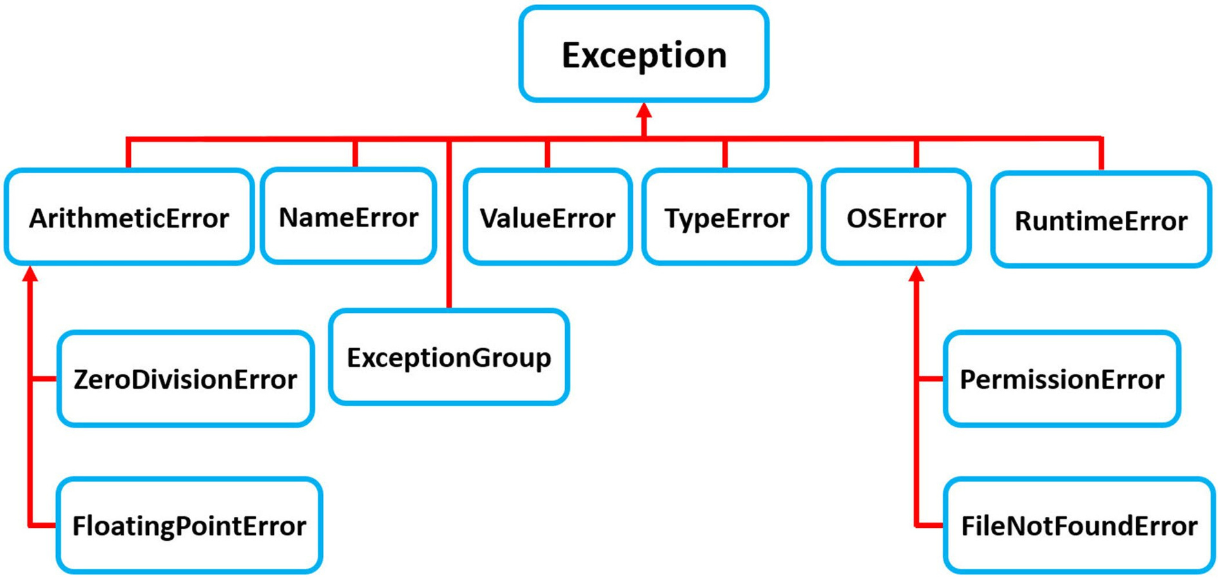

Slide 6
1. Try-Except Block
The basic structure for handling exceptions.
try:
x = 1 / 0
except ZeroDivisionError:
print("Cannot divide by zero!")
2. Multiple Except Blocks
Handle different exceptions differently.
try:
value = int("abc")
except ValueError:
print("ValueError occurred")
except TypeError:
print("TypeError occurred")

Slide 7
3. Single Except Handling Multiple Exceptions
Use a tuple to catch multiple exceptions with the same handler.
try:
x = int("abc")
except (ValueError, TypeError):
print("Either ValueError or TypeError occurred")
4. Generic Exception Handling
Catch any exception, but use with caution as it can hide bugs.
try:
risky_code()
except Exception as e:
print(f"An error occurred: {e}")

Slide 8
5. Custom Exceptions
Define your own error types for more specific handling.
class MyCustomError(Exception):
pass
def do_something():
raise MyCustomError("Something went wrong!")
try:
do_something()
except MyCustomError as e:
print(e)

Slide 9
✅ Summary: Error Handling in Python
🔹 Key Components:
try block: Code that might raise an exception.
except block: Code that runs if an exception occurs.
else block (optional): Runs if no exception is raised.
finally block (optional): Always runs, used for cleanup actions.
🔹 Why Use Error Handling?
Prevents program crashes.
Makes your code more robust and user-friendly.
Helps in debugging and logging.
Ensures proper cleanup (like closing files or database connections).

Slide 10


Thank You!
M.Thanush
HTNO: 23420831047028
3RD BCA
Notes:
10

